Slide 1
Predicting solar storms
The extreme Bad Weather Day on earth
Wayne heller
MAY 2016

Slide 2
What are the goals
Build a predictive model to estimate the geomagnetic activity on Earth in response to solar storms
Identify the factors on the Sun that result in high levels of geomagnetic activity on the Earth
Identify patterns on the Sun that can help predict Carrington-class Events.

Slide 3
Summary of DaTa and Modeling Approach
Satellite Data (Features)
(Response)
CME
SOHO-LASCO
LINEAR SPEED
SPEED @ 20 SOLAR RADII
SOLAR FLARE
GOES
C, M, X
OPT 1, 2, 3
RADIO FLUX
SOLAR PARTICLE
GOES
PROTON & ELECTRON FLUX
SOLAR PARTICLE
ACE
PROTON TEMP, DENSITY, SPEED, RATIO TO ALPHA
GEOMAGNETIC
ACTIVITY
C9 (DAILY SUMMARY)
Kp (3hr)
Time Series Data (1997 – 2014)
Kp_max
Linear Regression
Logistic Regression
K means clustering
Rolling Sum Data (1997 – 2014)
C9
Logistic Regression
K means clustering

Slide 4
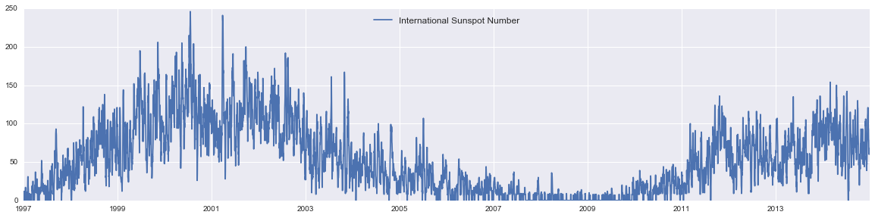
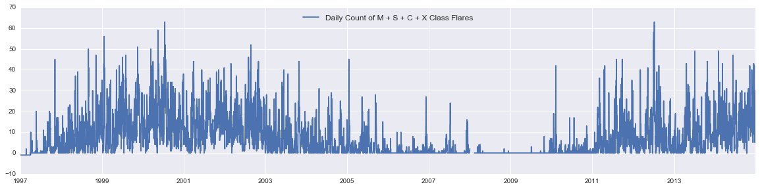
Data Exploration (“The Good”) expected correlation between sunspot number solar flares

Slide 5
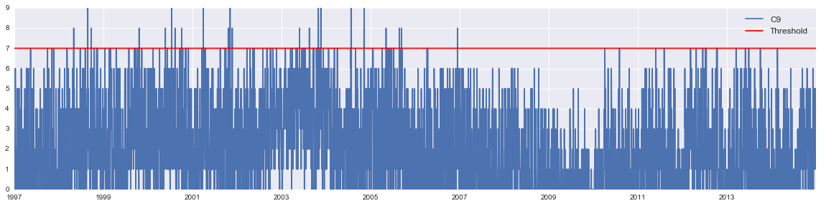
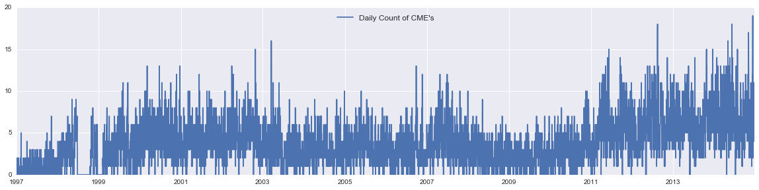
Data Exploration (“The bad and the ugly”) sparse data relative to the overall population
Data Exploration (“The bad and the ugly”) DUBIOUS CORRELATION BETWEEN FEATURES AND RESPONSE
(Response)
(Features)

Slide 6
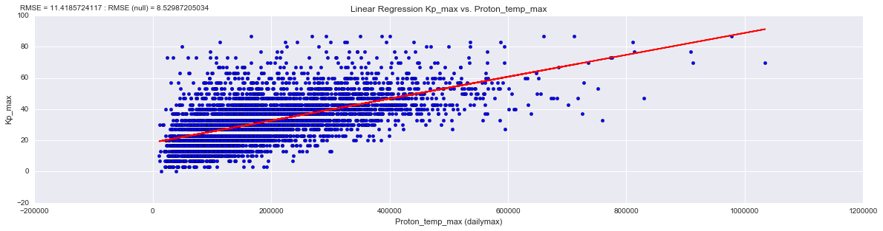
Data analysis (linear regression) root mean square error of all models > null hypothesis
RMSE = 11.4
RMSE (NULL) = 8.5

Slide 7
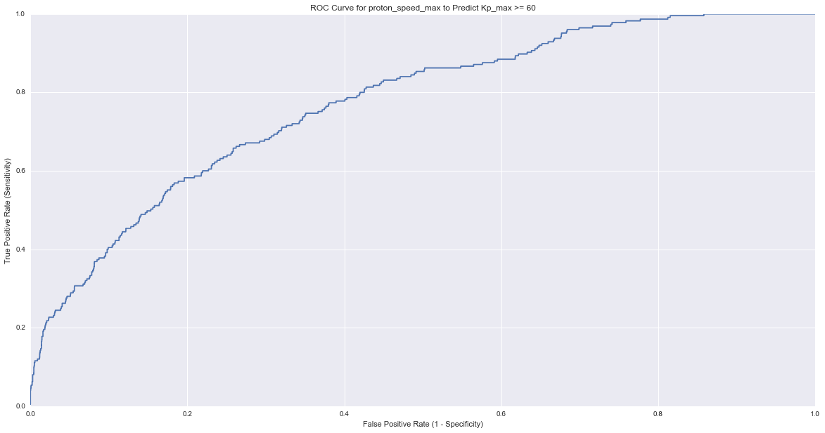
Data analysis (logistic regression) unfavorable predictor given high false positive rate
True Positive 80%
False Positive 40%

Slide 8
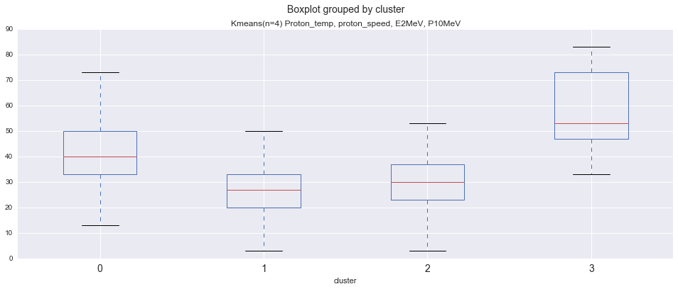
Data analysis (k-means) strong clustering results but undermined by sparseness of data

Slide 9
Summary AND NEXT STEPS
Rolling sums improved accuracy.
More feature data complexity to unravel
Not yet considered features that describe the state of the Earth’s magnetic field
Notes:
Rolling sum - e.g. 2 day sum of Proton temp yields a model that is 25% accurate at predicting Kp_max > 60.

Slide 10
CURRENT PROGRESS AGAINST GOALS
Build a predictive model to estimate the geomagnetic activity on Earth in response to solar storms
Identify the factors on the Sun that result in high levels of geomagnetic activity on the Earth
Identify patterns on the Sun that can help predict Carrington-class Events.

Slide 11
Appendix

Slide 12
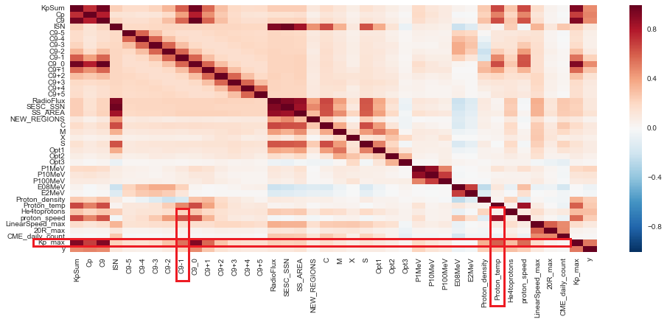
Correlation matrix of features

